Slide 1

Sales Data Analysis Using Microsoft Excel
Academic Project — Business & Data Analysis
Prepared By
Class
Balpreet Kaur
24BSC 1-A
Submitted To
Parwan Sir
Notes:
1

Slide 2




Introduction
What Is Sales Data Analysis?
The process of collecting, organizing, and examining sales data to uncover patterns, trends, and actionable business insights.
Why It Matters in Business
Informed decisions — from inventory planning to marketing strategy — rely on accurate, well-analyzed sales data.
Excel's Role
Microsoft Excel provides an accessible, powerful platform for data entry, formula-based calculations, and visual chart creation.
Notes:
2

Slide 3


Problem Statement
Most businesses collect large volumes of sales data — but fail to analyze it effectively.
Data Without Direction
Raw data sitting in spreadsheets provides no value unless properly organized and examined.
Poor Decision-Making
Without analysis, businesses risk overstocking, missed revenue opportunities, and slow responses to market shifts.
The Solution
Structured analysis using Excel transforms raw numbers into clear, actionable business intelligence.
Notes:
3

Slide 4

Project Objectives
1
2
Analyze Sales Data
Calculate Key Metrics
Import and organize real-world sales data within Excel for structured review.
Use formulas to compute total sales, total revenue, and product-level breakdowns.
3
4
Identify Top Performers
Visualize the Data
Pinpoint best- and worst-performing products using MAX, MIN, and conditional logic.
Build bar charts and pie charts to communicate findings clearly and persuasively.
Notes:
4

Slide 5

Tools & Techniques Used
Microsoft Excel
The primary tool used throughout this project for data entry, analysis, and visualization.
Additionally: Bar charts, Pie charts, Pivot Tables, Conditional Formatting, Sorting & Filtering.
SUM
MAX / MIN
IF
Total sales & revenue
Top & lowest performers
Conditional logic
Notes:
5

Slide 6

Dataset Overview
The dataset captures product-level sales records, including quantity sold and unit pricing — forming the foundation of all calculations.
Product Name
Quantity Sold
Unit Price ($)
Total Sales ($)
Laptop
50
800
40,000
Smartphone
120
500
60,000
Headphones
200
80
16,000
Tablet
75
350
26,250
Smartwatch
90
200
18,000
Formula used: Total Sales = Quantity × Unit Price — applied using Excel's cell referencing (e.g., =B2*C2)
Notes:
6

Slide 7





Steps in Excel: From Data to Insight
Find MAX/MIN
Enter Data
SUM Total
Revenue
Following this structured workflow ensures consistent, repeatable analysis — and reduces the risk of formula errors across the dataset.
Notes:
7

Slide 8

Data Preprocessing
Remove Duplicates
1
Use Data → Remove Duplicates to eliminate repeated records that skew totals.
Handle Missing Values
2
Identify blank cells using ISBLANK() and fill or flag them appropriately.
Correct Formatting
Ensure numbers are formatted as Currency or Number — not stored as text — to enable accurate calculations.
3
Notes:
8

Slide 9
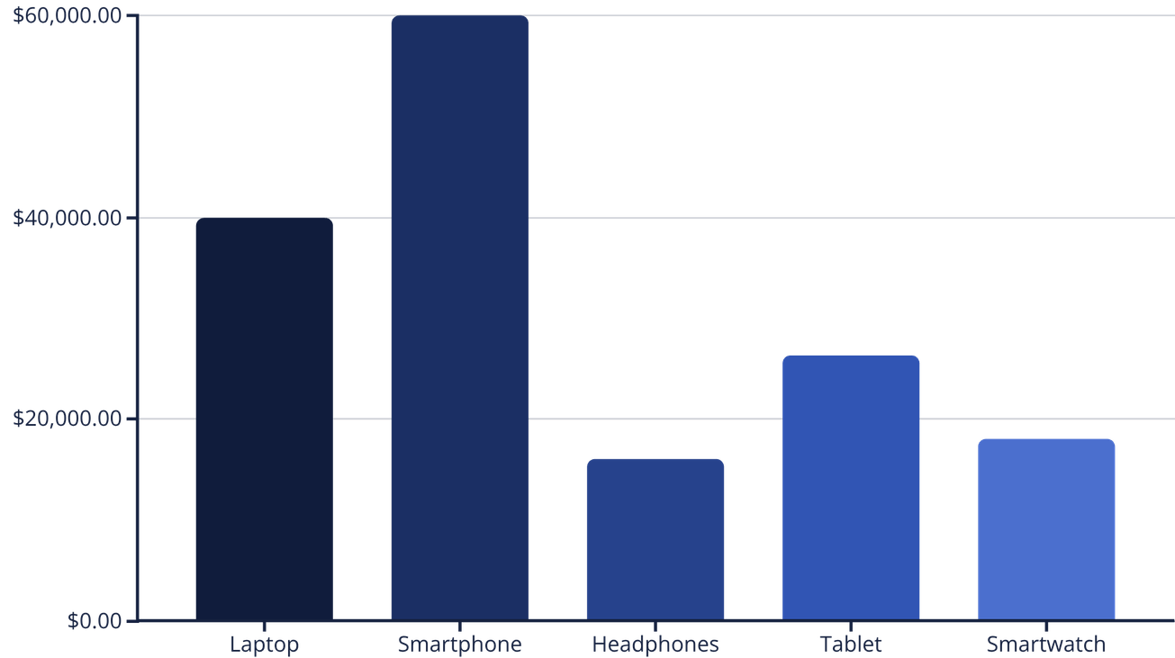

Data Visualization
Laptop
Smartphone
Headphones
Tablet
Smartwatch
Bar chart compares absolute sales by product; donut chart shows each product's share of total revenue.
Notes:
9

Slide 10









Advanced Excel Features
IF Function
Flag products as "High" or "Low" performers based on a sales threshold.
Conditional Formatting
Instantly highlight top values, low performers, or data ranges with color scales.
Sort & Filter
Quickly isolate specific products, date ranges, or sales brackets for focused analysis.
Pivot Tables
Summarize large datasets dynamically — group, aggregate, and drill down without formulas.
Notes:
10

